Slide 1

Year 8 Options
2017

Slide 2
Why now?
3 years for your GCSEs instead of 2 years
Opportunity to study subjects in more depth
Opportunity to take more GCSEs
Reduced time pressure
Better GCSE results

Slide 3


Core Subjects
All students will study:
English Language and English Literature
Mathematics
Combined Science or Triple Science
Religious Studies
Core PE

Slide 4

Government Requirements
All students must take at least one of the following:
French
History
Geography

Slide 5
Choose up to 3 further subjects…
Art
Photography
Hospitality & Catering
Design & Technology
Drama
Citizenship
Business Studies
ICT
Music
Personal & Social Development
Physical Education
... also choose two reserve subjects!

Slide 6
English Baccalaureate
  English Baccalaureate (EBacc) is a performance measure, not a qualification
  French & History or Geography GCSEs

Slide 7

Top Tips
Choose a balanced range of subjects
Consider future aspirations
Consider your performance in each subject
Give serious consideration to your reserve subjects

Slide 8

Possible Pitfalls
Too much focus on a single career path
Little attention given to course structure
Picking subjects to be with your friends
Picking subjects to be with your favourite teacher

Slide 9
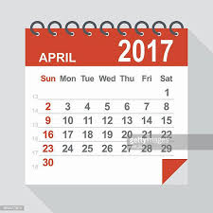
Timeline
27th April – Options Evening
1st May - Individual Options Meetings
12th May – Options form Deadline

Slide 10
Tonight
Visit your possible subjects
Ask questions
Remember to consider six subjects – four first choices and two reserve subjects

Slide 11
FINAL DEADLINE
FOR COMPLETED FORMS TO BE
HANDED TO FRONT OFFICE
12th May 2017

